Slide 1
OllyDbg (Immunity Dbg)
Slides: Thanks to S. Bowne

Slide 2
History
OllyDbg was developed more than a decade ago
First used to crack software and to develop exploits
The OllyDbg 1.1 source code was purchased by Immunity and rebranded as Immunity Debugger
The two products are very similar

Slide 3
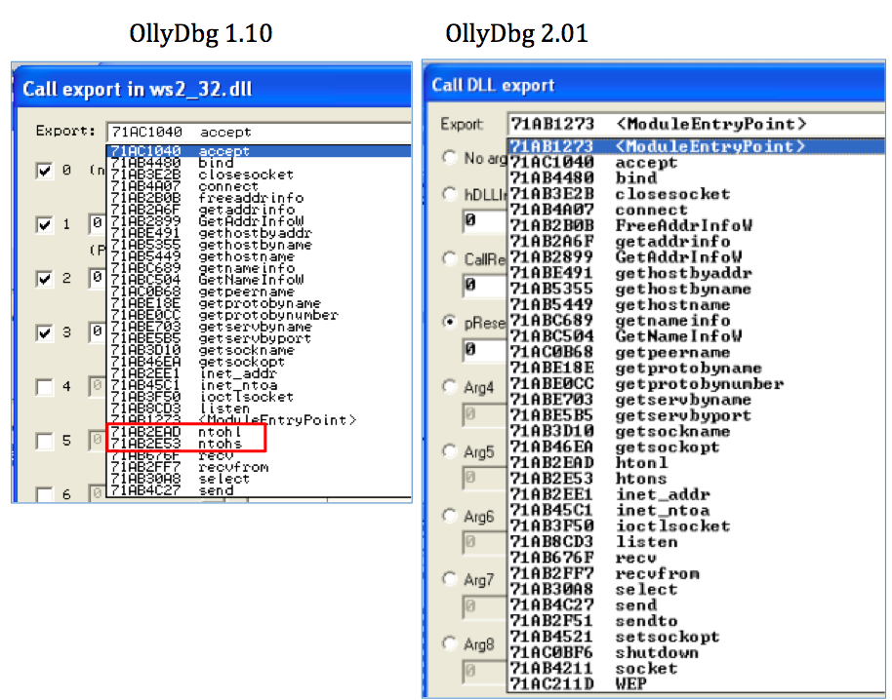

Don't Use OllyDbg 2!

Slide 4
Loading Malware

Slide 5
Ways to Debug Malware
You can load EXEs or DLLs directly into OllyDbg
If the malware is already running, you can attach OllyDbg to the running process

Slide 6
Opening an EXE
File, Open
Add command-line arguments if needed
OllyDbg will stop at the entry point, WinMain, if it can be determined
Otherwise it will break at the entry point defined in the PE Header
  Configurable in Options, Debugging Options

Slide 7
Attaching to a Running Process
File, Attach
OllyDbg breaks in and pauses the program and all threads
  If you catch it in DLL, set a breakpoint on access to the entire code section to get to the interesting code

Slide 8
Reloading a File
Ctrl+F2 reloads the current executable
F2 sets a breakpoint

Slide 9
The OllyDbg Interface

Slide 10
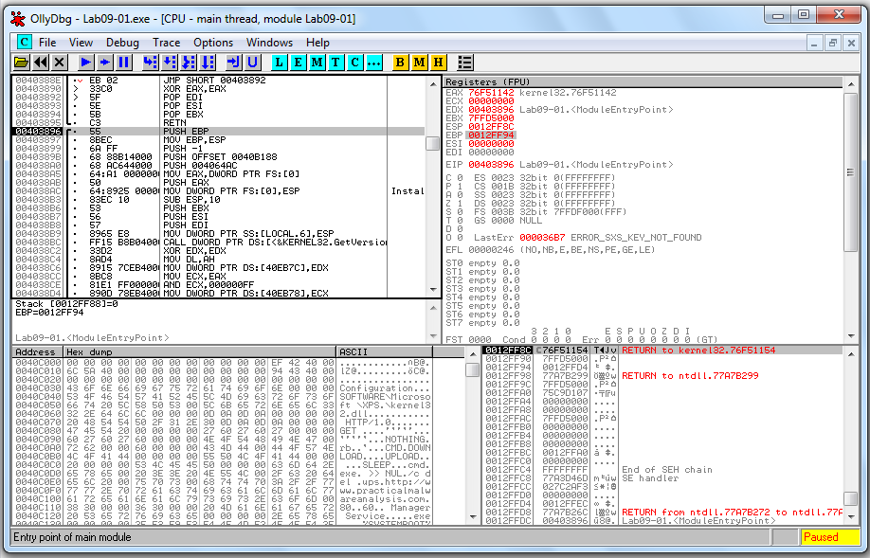
Registers
Disassembler
Highlight: next instruction to be executed
Stack
Memory
dump

Slide 11
Modifying Data
Disassembler window
  Press spacebar
Registers or Stack
  Right-click, modify
Memory dump
  Right-click, Binary, Edit
  Ctrl+G to go to a memory location
  Right-click a memory address in another pane and click "Follow in dump"

Slide 12
Memory Map
View, Memory Map

Slide 13
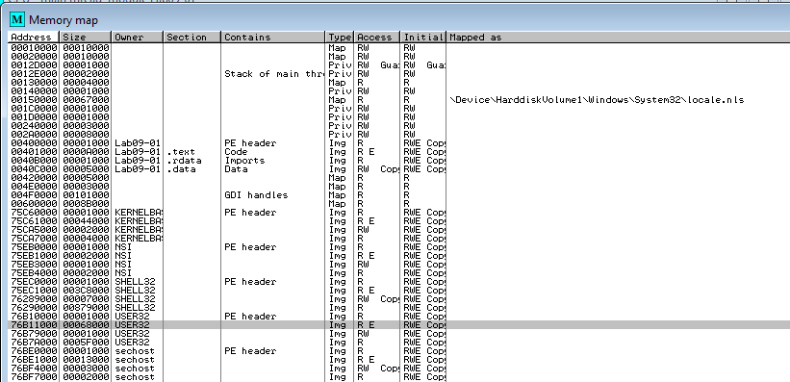
EXE and DLLs are identified
Double-click any row to show a memory dump
Right-click, View in Disassembler

Slide 14
Rebasing
Rebasing occurs when a module is not loaded at its preferred base address
PE files have a preferred base address
  The image base in the PE header
  Usually the file is loaded at that address
  Most EXEs are designed to be loaded at 0x00400000
EXEs that support Address Space Layout Randomization (ASLR) will often be relocated

Slide 15
DLL Rebasing
DLLs are more commonly relocated
  Because a single application may import many DLLs
  Windows DLLs have different base addresses to avoid this
  Third-party DLLs often have the same preferred base address

Slide 16
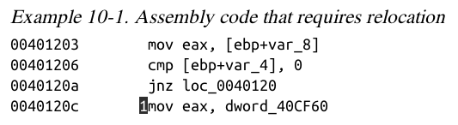
Absolute v. Relative Addresses
The first 3 instructions will work fine if relocated because they use relative addresses
The last one has an absolute address that will be wrong if the code is relocated

Slide 17
Fix-up Locations
Most DLLS have a list of fix-up locations in the .reloc section of the PE header
  These are instructions that must be changed when code is relocated
DLLs are loaded after the EXE and in any order
You cannot predict where DLLs will be located in memory if they are rebased

Slide 18
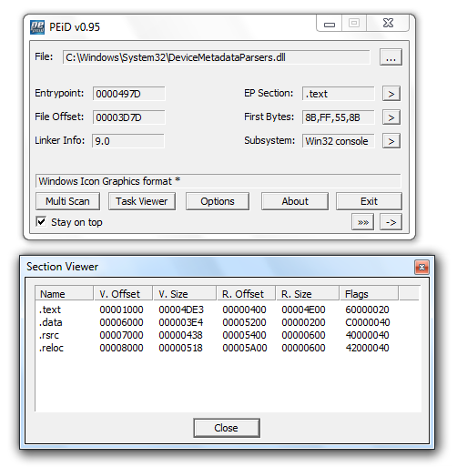

Slide 19
DLL Rebasing
DLLS can have their .reloc removed
  Such a DLL cannot be relocated
  Must load at its preferred base address
Relocating DLLs is bad for performance
  Adds to load time
  So good programmers specify non-default base addresses when compiling DLLs

Slide 20
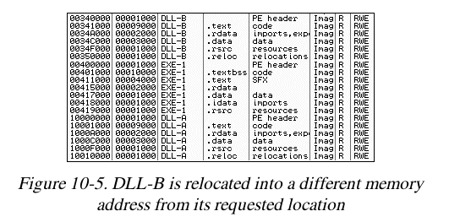
Example of DLL Rebasing
Olly Memory Map
DLL-A and DLL-B prefer location 0x100000000

Slide 21
IDA Pro
IDA Pro is not attached to a real running process
It doesn't know about rebasing
If you use OllyDbg and IDA Pro at the same time, you may get different results
  To avoid this, use the "Manual Load" option in IDA Pro
  Specify the virtual base address manually

Slide 22
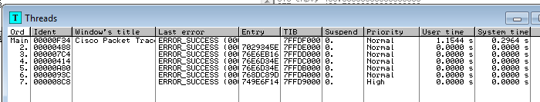
Viewing Threads and Stacks
View, Threads
Right-click a thread to "Open in CPU", kill it, etc.

Slide 23
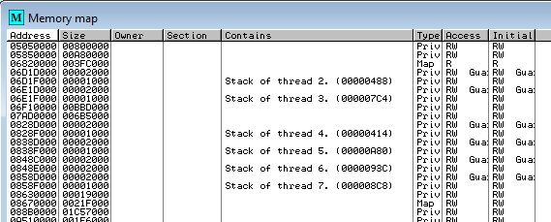
Each Thread Has its Own Stack
Visible in Memory Map

Slide 24
Executing Code

Slide 25
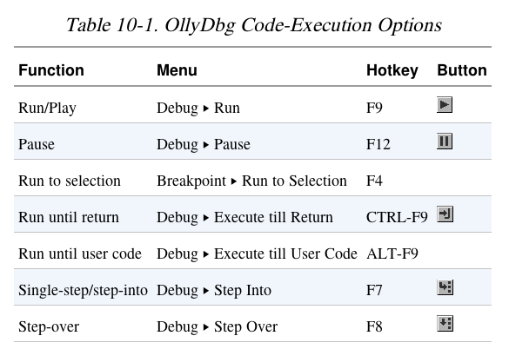

Slide 26
Run and Pause
You could Run a program and click Pause when it's where you want it to be
But that's sloppy and might leave you somewhere uninteresting, such as inside library code
Setting breakpoints is much better

Slide 27
Run and Run to Selection
Run is useful to resume execution after hitting a breakpoint
Run to Selection will execute until just before the selected instruction is executed
  If the selection is never executed, it will run indefinitely

Slide 28
Execute till Return
Pauses execution until just before the current function is set to return
Can be useful if you want to finish the current function and stop
But if the function never ends, the program will continue to run indefinitely

Slide 29
Execute till User Code
Useful if you get lost in library code during debugging
Program will continue to run until it hit compiled malware code
  Typically the .text section

Slide 30
Stepping Through Code
F7 -- Single-step (also called step-into)
F8 -- Step-over
  Stepping-over means all the code is executed, but you don't see it happen
Some malware is designed to fool you, by calling routines and never returning, so stepping over will miss the most important part

Slide 31
Breakpoints

Slide 32
Types of Breakpoints
Software breakpoints
Hardware breakpoints
Conditional breakpoints
Breakpoints on memory
F2 – Add or remove a breakpoint

Slide 33
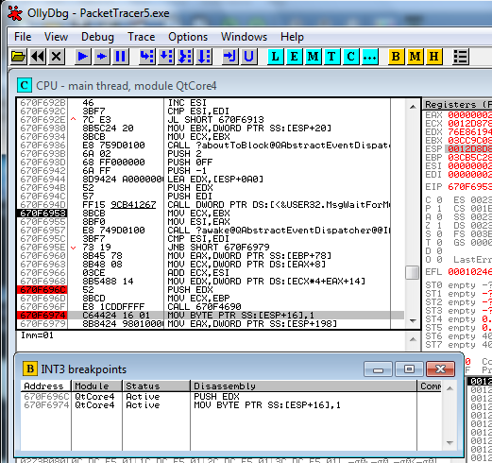
Viewing Active Breakpoints
View, Breakpoints, or click B icon on toolbar

Slide 34
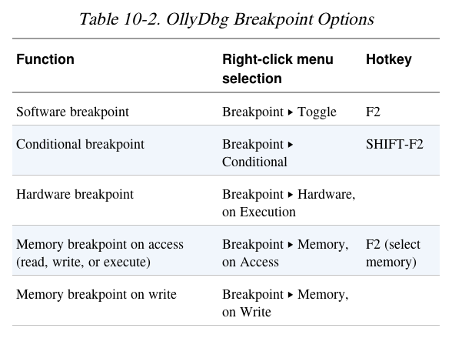

Slide 35
Saving Breakpoints
When you close OllyDbg, it saves your breakpoints
If you open the same file again, the breakpoints are still available

Slide 36
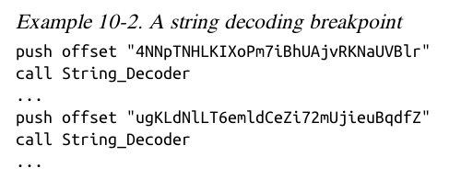
Software Breakpoints
Useful for string decoders
Malware authors often obfuscate strings
  With a string decoder that is called before each string is used

Slide 37
String Decoders
Put a breakpoint at the end of the decoder routine
The string becomes readable on the stack
Each time you press Play in OllyDbg, the program will execute and will break when a string is decoded for use
This method will only reveal strings as they are used

Slide 38
Conditional Breakpoints
Breaks only when a condition is true
Ex: Poison Ivy backdoor
  Poison Ivy allocates memory to house the shellcode it receives from Command and Control (C&C) servers
  Most memory allocations are for other purposes and uninteresting
  Set a conditional breakpoint at the VirtualAlloc function in Kernel32.dll

Slide 39
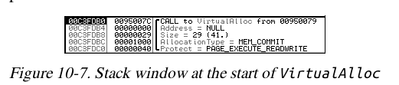
Normal Breakpoint
Put a standard breakpoint at the start of the VirtualAlloc function
Here's the stack when it hits, showing five items:
  Return address
  4 parameters (Address, Size, AllocationType, Protect)

Slide 40
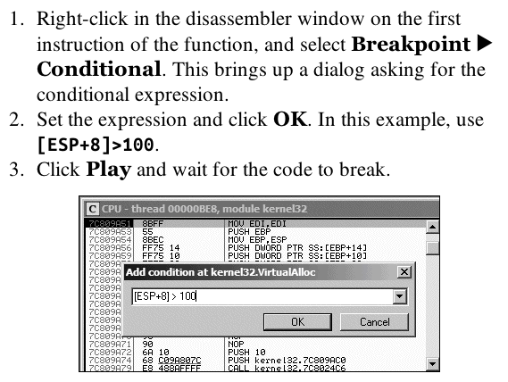
Conditional Breakpoint

Slide 41
Hardware Breakpints
Don't alter code, stack, or any target resource
Don't slow down execution
But you can only set 4 at a time
Click Breakpoint, "Hardware, on Execution"
You can set OllyDbg to use hardware breakpoints by default in Debugging Options
  Useful if malware uses anti-debugging techniques

Slide 42
Memory Breakpoints
Code breaks on access to specified memory location
OllyDbg supports software and hardware memory breakpoints
Can break on read, write, execute, or any access
Right-click memory location, click Breakpoint, "Memory, on Access"

Slide 43
Memory Breakpoints
You can only set one memory breakpoint at a time
OllyDbg implements memory breakpoints by changing the attributes of memory blocks
This technique is not reliable and has considerable overhead
Use memory breakpoints sparingly

Slide 44
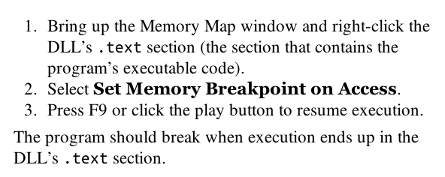
When is a DLL Used?

Slide 45
Loading DLLs

Slide 46
loaddll.exe
DLLs cannot be executed directly
OllyDbg uses a dummy loaddll.exe program to load them
Breaks at the DLL entry point DLLMain once the DLL is loaded
Press Play to run DLLMain and initialize the DLL for use

Slide 47
Demo
Get OllyDbg 1.10, NOT 2.00 or 2.01
  Link Ch 9a
Use Win XP or Win 7
In OllyDbg, open c:\windows\system32\ws2_32.dll
Debug, Call DLL Export – it fails
Reload the DLL, click Run button once
Debug, Call DLL Export – now it works

Slide 48
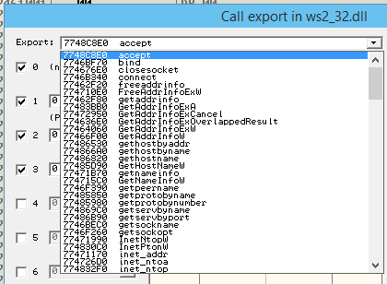
Call Exports in ws2_32.dll

Slide 49
ntohl
Converts a 32-bit number from network to host byte order
Click argument 1, type in 7f000001
  127.0.0.1 in "network" byte order
Click "Follow in Disassembler" to see the code
Click "Call" to run the function
Answer in EAX

Slide 50
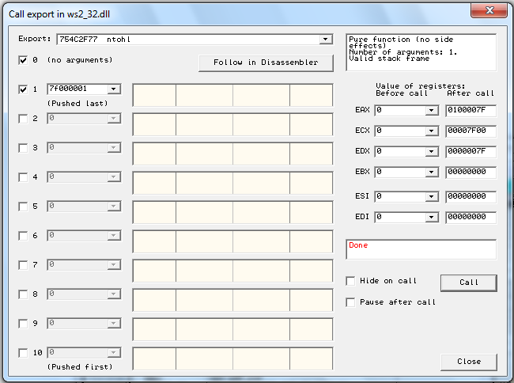

Slide 51
Don't Use OllyDbg 2!

Slide 52
Tracing

Slide 53
Tracing
Powerful debugging technique
Records detailed execution information
Types of Tracing
  Standard Back Trace
  Call Stack Trace
  Run Trace

Slide 54
Standard Back Trace
You move through the disassembler with the Step Into and Step Over buttons
OllyDbg is recording your movement
Use minus key on keyboard to see previous instructions
  But you won't see previous register values
Plus key takes you forward
  If you used Step Over, you cannot go back and decide to step into

Slide 55
Call Stack Trace
Views the execution path to a given function
Click View, Call Stack
Displays the sequence of calls to reach your current location

Slide 56
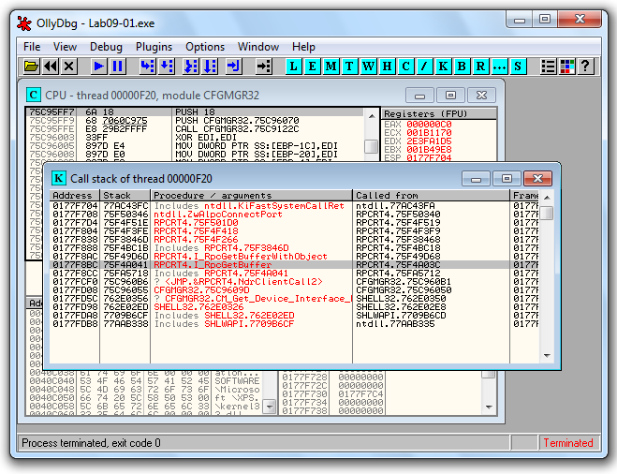

Slide 57
Run Trace
Code runs, and OllyDbg saves every executed instruction and all changes to registers and flags
Highlight code, right-click, Run Trace, Add Selection
After code executes, View, Run Trace
  To see instructions that were executed
  + and - keys to step forward and backwards

Slide 58
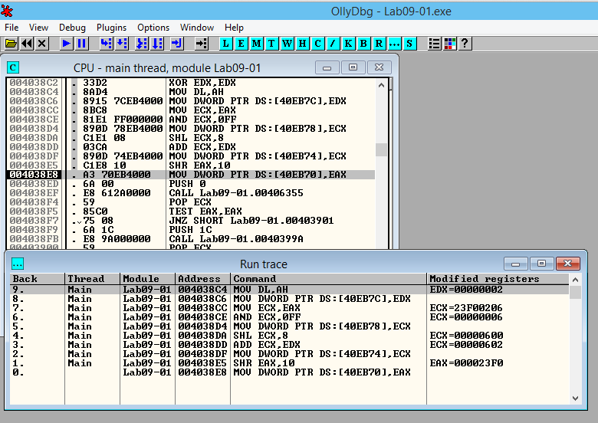

Slide 59
Trace Into and Trace Over
Buttons below "Options"
Easier to use than Add Selection
If you don't set breakpoints, OllyDbg will attempt to trace the entire program, which could take a long time and a lot of memory

Slide 60
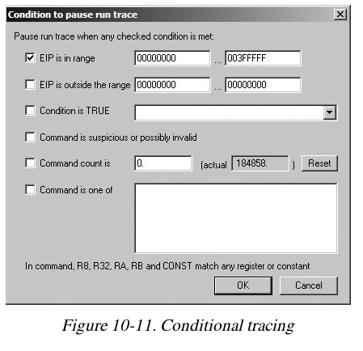
Debug, Set Condition
Traces until a condition hits
This condition catches Poison Ivy shellcode, which places code in dynamically allocated memory below 0x400000

Slide 61
Exception Handling

Slide 62
When an Exception Occurs
OllyDbg will stop the program
You have these options to pass the exception into the program:
  Shift+F7 Step into exception
  Shift+F8: Step over exception
  Shift+F9: Run exception handler
Often you just ignore all exceptions in malware analysis
  We aren't trying to fix problems in code

Slide 63
Patching

Slide 64
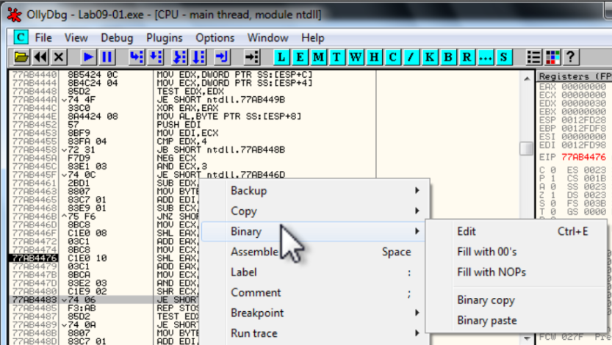
Binary Edit

Slide 65
Fill
Fill with 00
Fill with NOP (0x90)
  Used to skip instructions
  e.g. to force a branch

Slide 66
Saving Patched Code
Right-click disassembler window after patching
  Copy To Executable, All Modifications, Save File
  Copy All
Right-click in new window
  Save File

Slide 67
Analyzing Shellcode
Undocumented technique

Slide 68
Easy Way to Analyze Shellcode
Copy shellcode from a hex editor to clipboard
Within memory map, select a region of type "Priv" (Private memory)
Double-click rows in memory map to show a hex dump
  Find a region of hundreds of consecutive zeroes
Right-click chosen region in Memory Map, Set Access, Full Access (to clear NX bit)

Slide 69
Analyzing Shellcode
Highlight a region of zeroes, Binary, Binary Paste
Set EIP to location of shellcode
  Right-click first instruction, New Origin Here

Slide 70
Assistance Features

Slide 71
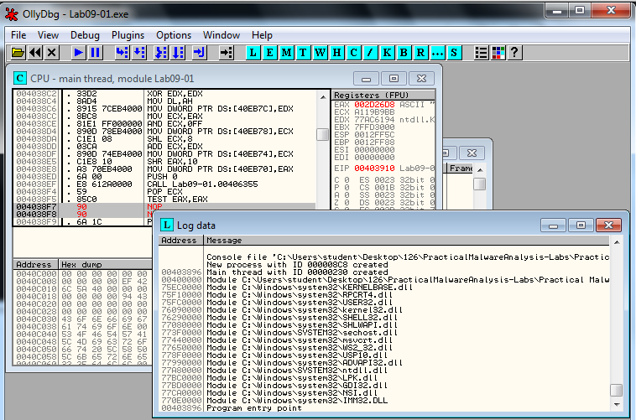
Log
View, Log
  Shows steps to reach here

Slide 72
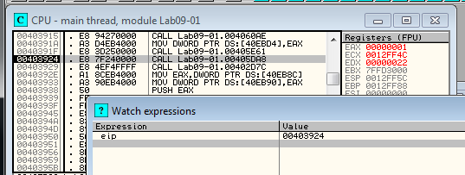
Watches Window
View, Watches
  Watch the value of an expression
  Press SPACEBAR to set expression
  OllyDbg Help, Contents
    Instructions for Evaluation of Expressions

Slide 73
Labeling
Label subroutines and loops
  Right-click an address, Label

Slide 74
Plug-ins

Slide 75
Recommended Plugins
OllyDump
  Dumps debugged process to a PE file
  Used for unpacking
Hide Debugger
  Hides OllyDbg from debugger detection
Command Line
  Control OllyDbg from the command line
  Simpler to just use WinDbg
Bookmarks
  Included by default in OllyDbg
  Bookmarks memory locations

Slide 76
Scriptable Debugging

Slide 77
Immunity Debugger (ImmDbg)
Unlike OllyDbg, ImmDbg employs python scripts and pas an easy-to-use API
Scripts are located in the PyCommands subdirectory under the install directory of ImmDbg
Easy to create custom scripts for ImmDbg

